Slide 1


An introduction to communicating about your models
Dr Cynthia C. S. Liem MMus
Associate Professor, Multimedia Computing Group, Delft University of Technology
c.c.s.liem@tudelft.nl | @informusiccs

Slide 2
Agenda
How I became a communicator
Communicating interdisciplinarily
Communicating for accountability
Communicating to laypeople
Conclusion

Slide 3
How I became a communicator
Notes:
Spend about 10 minutes on each concept

Slide 4
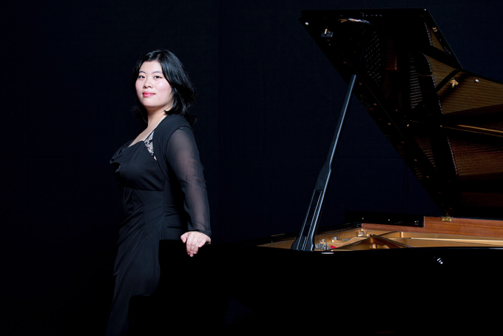
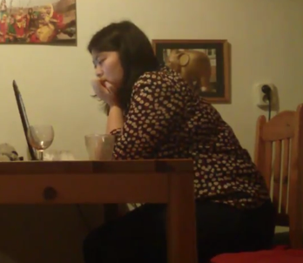
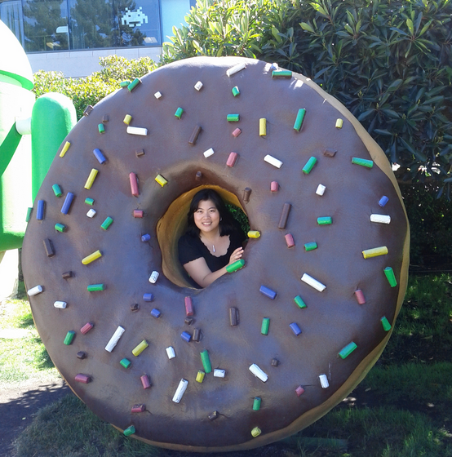
My background
© Marco Borggreve

Slide 5
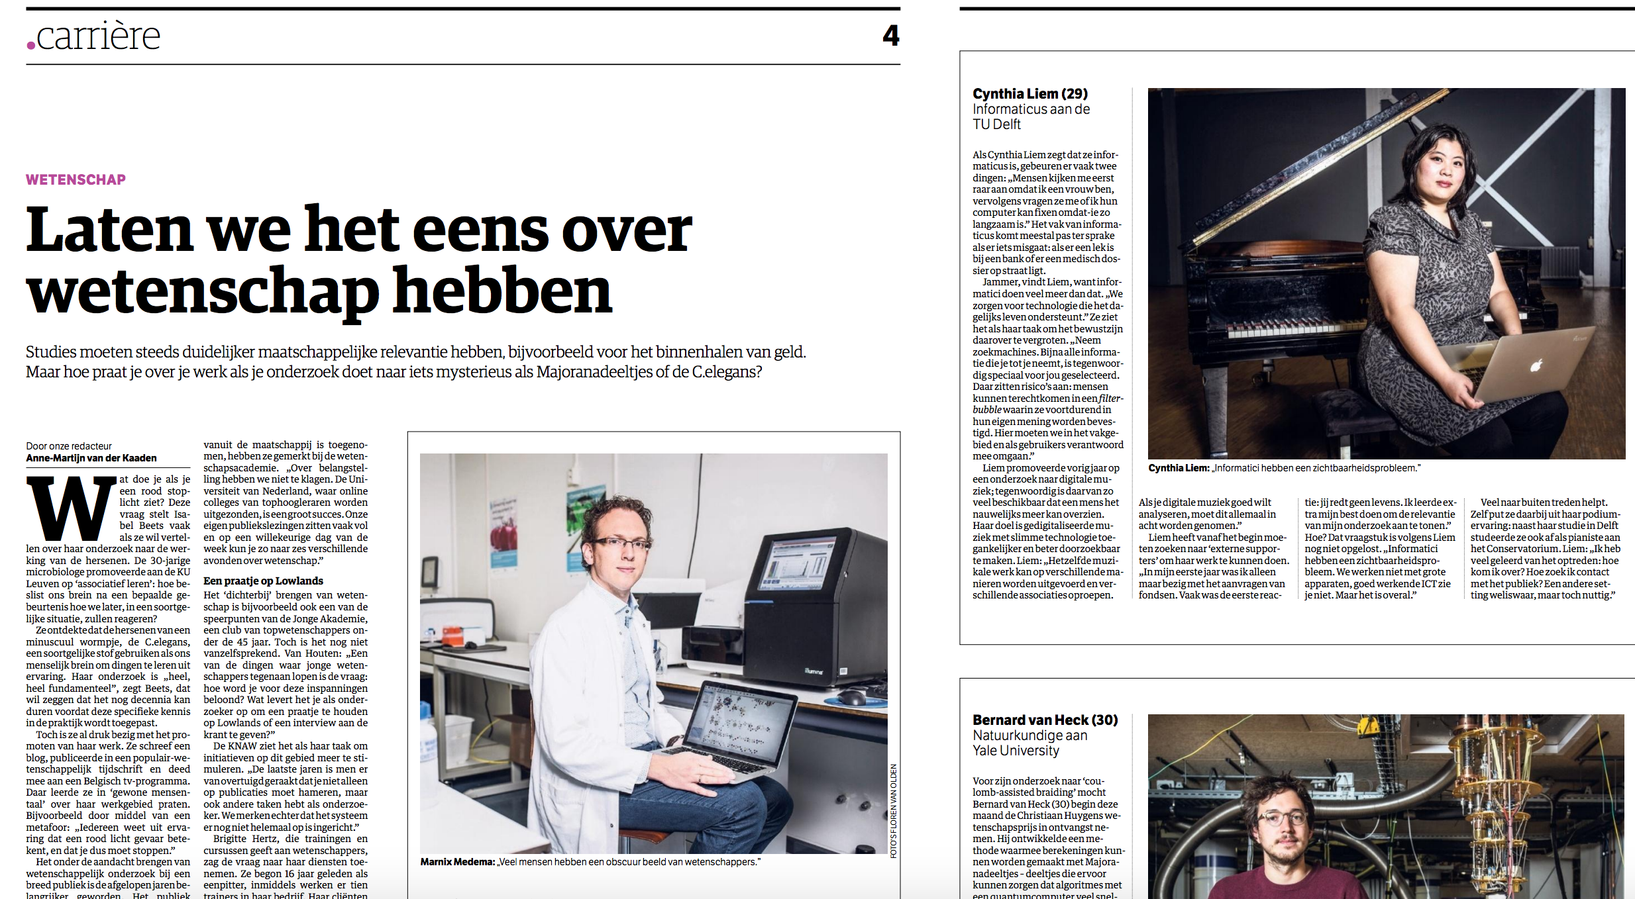
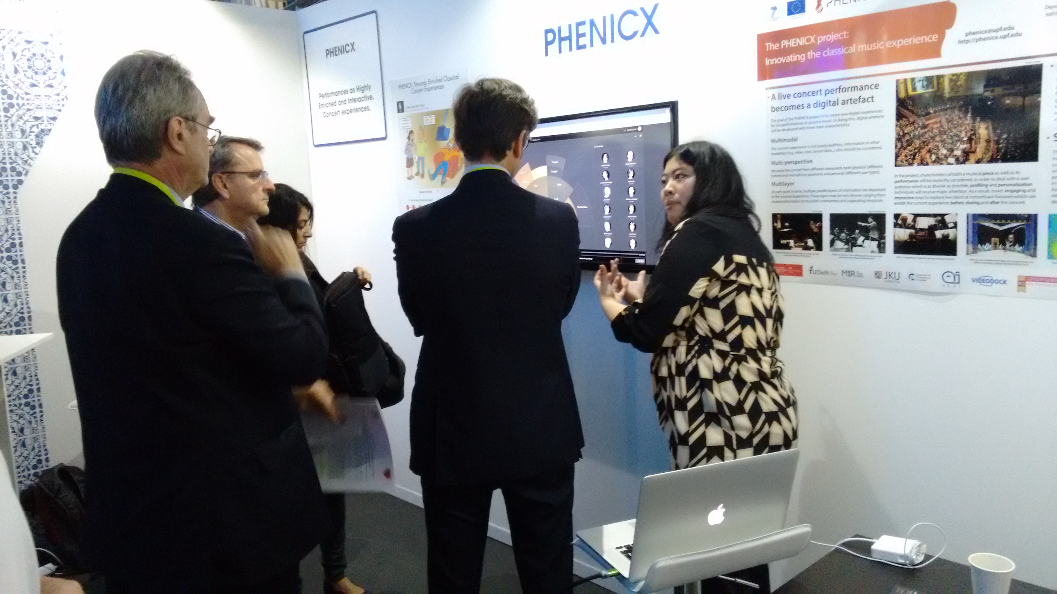
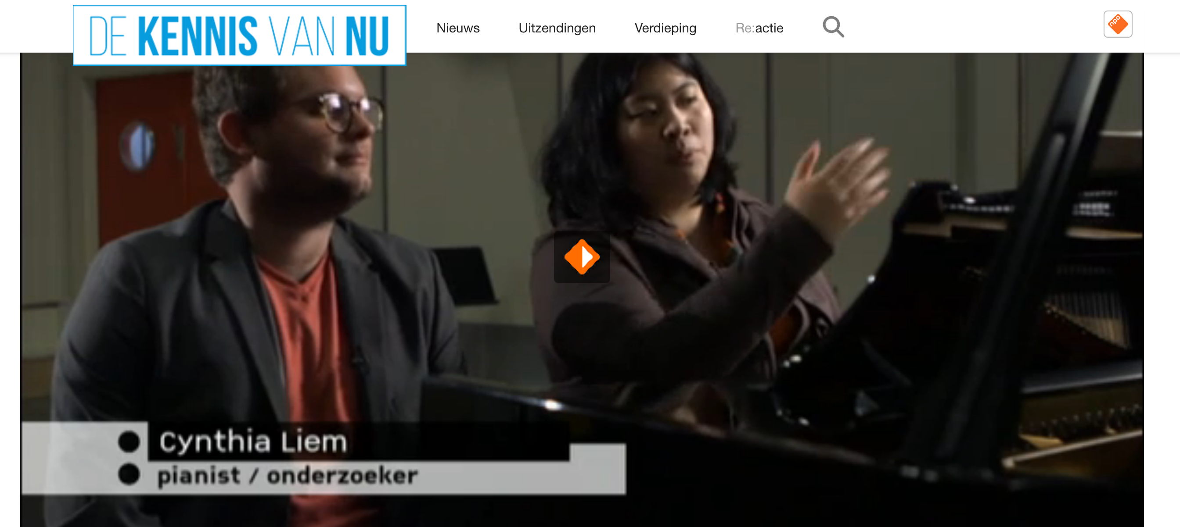
The music entrance

Slide 6
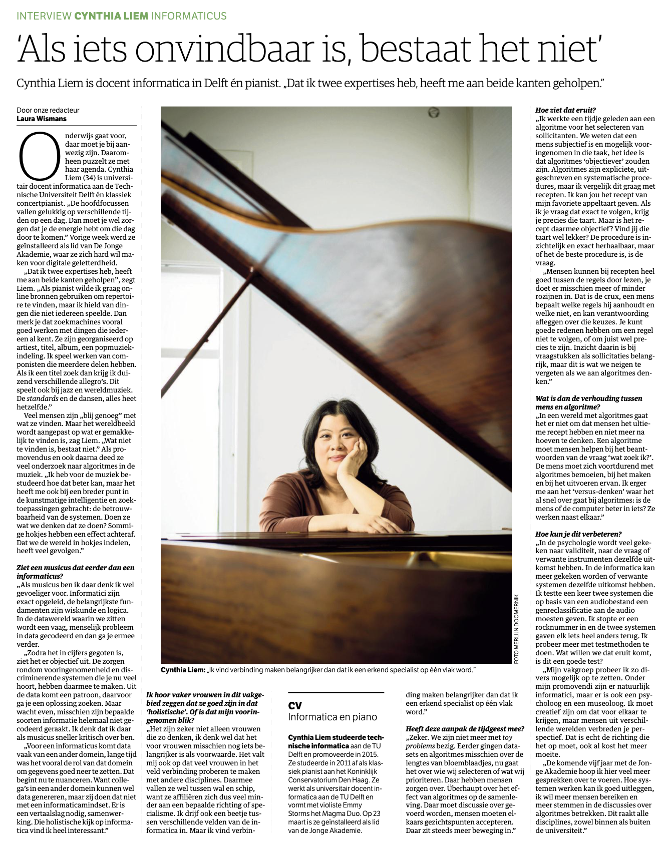
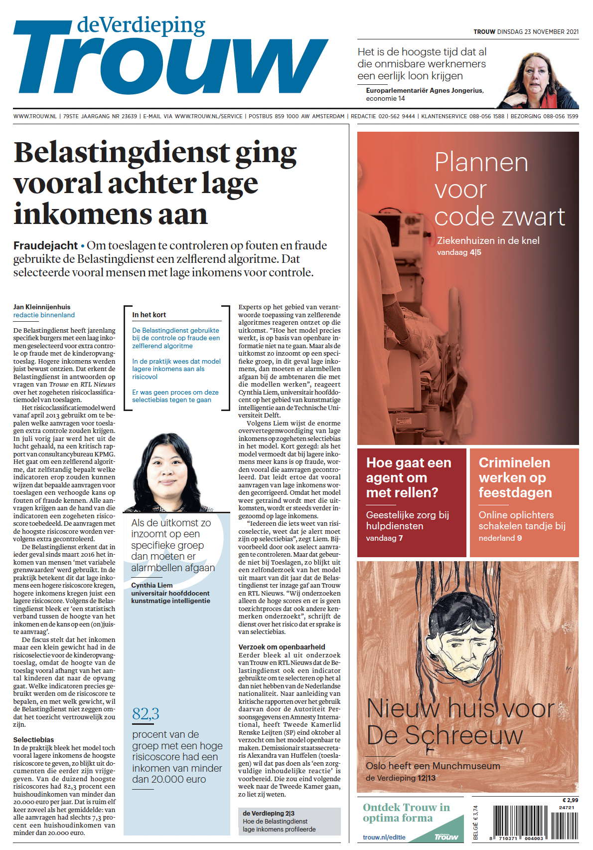
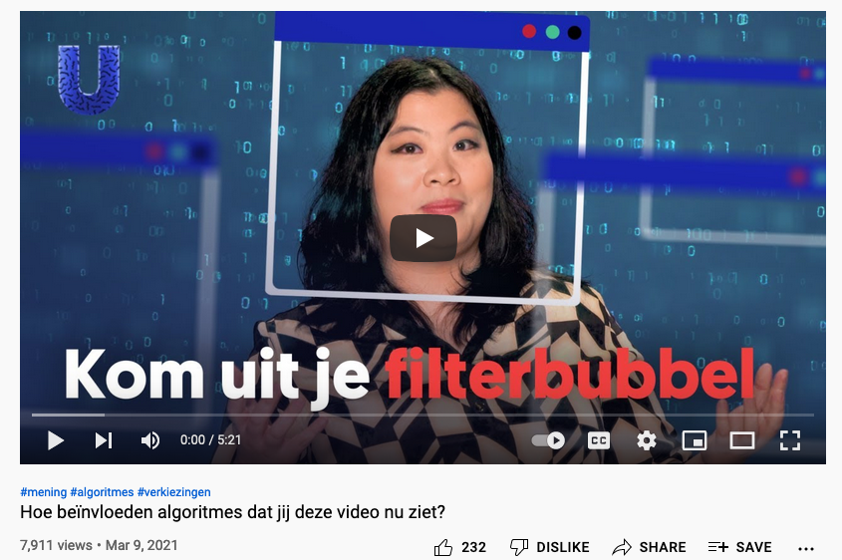
Today
https://www.trouw.nl/politiek/hoe-de-belastingdienst-lage-inkomens-profileerde-in-de-jacht-op-fraude~bbb66add/
https://www.nrc.nl/nieuws/2021/03/28/als-iets-onvindbaar-is-bestaat-het-niet-a4037549
https://www.youtube.com/watch?v=tnBcVwcoMYY

Slide 7
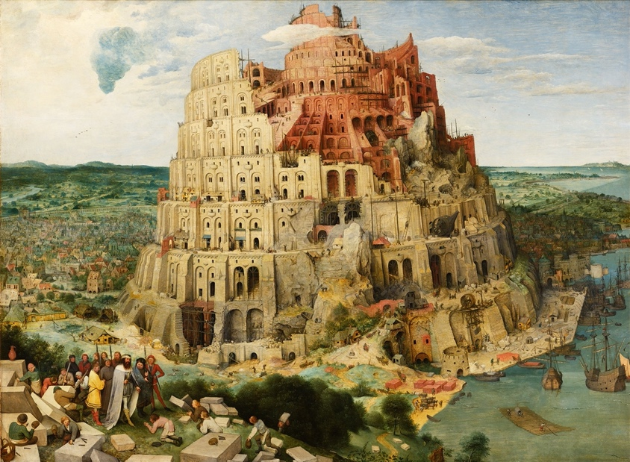
What I am encountering

Slide 8
Communicating interdisciplinarily
Notes:
Spend about 10 minutes on each concept

Slide 9

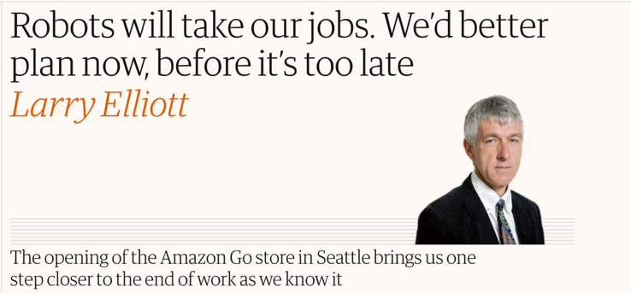
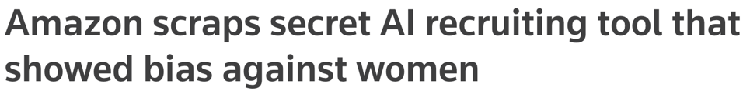


Promises and concerns

Slide 10
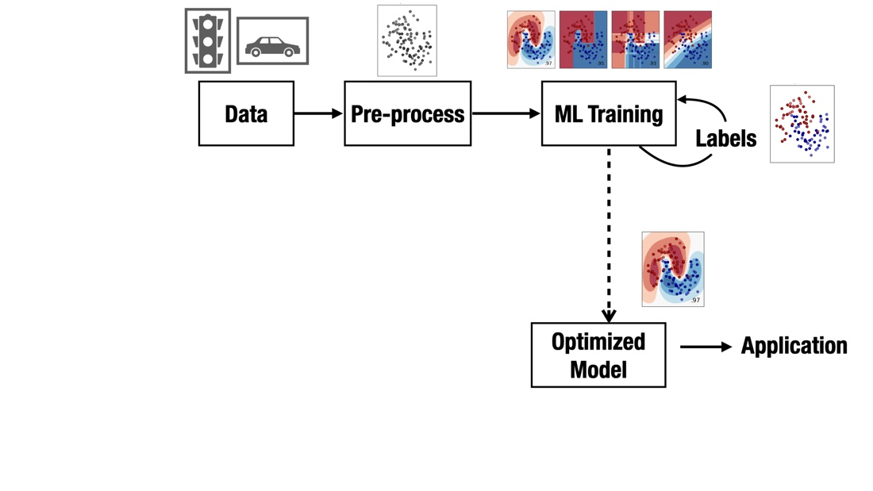
The setup

Slide 11
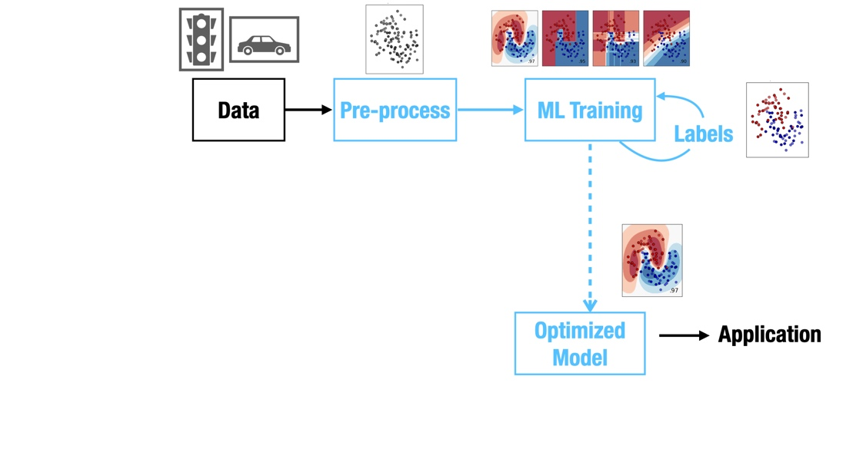
The ML expert’s focus

Slide 12
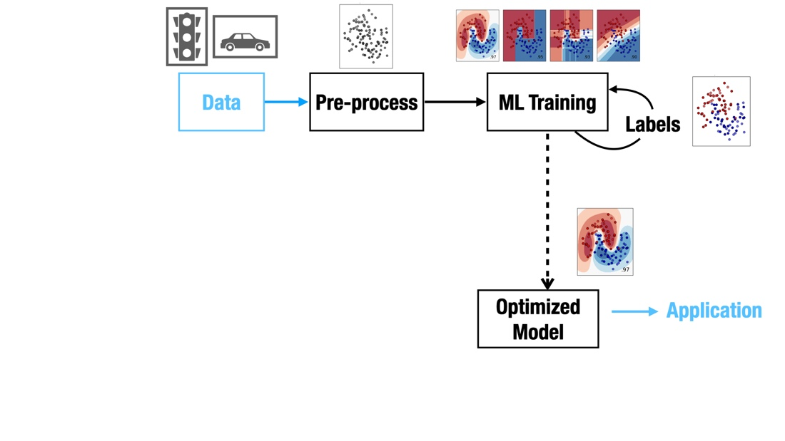
The domain expert’s focus

Slide 13
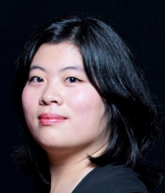
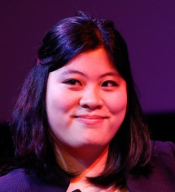

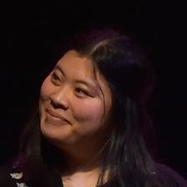
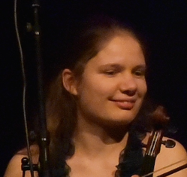


The ‘semantic gap’

Slide 14
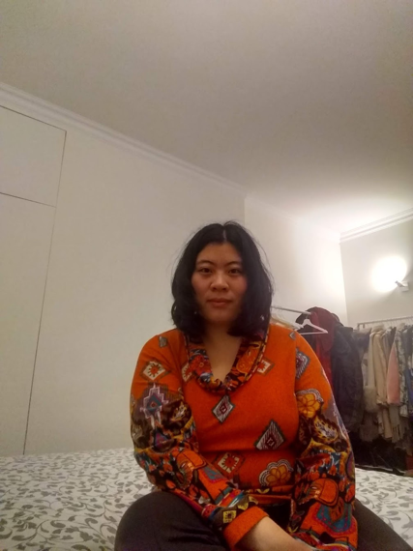


The ‘semantic gap’

Slide 15
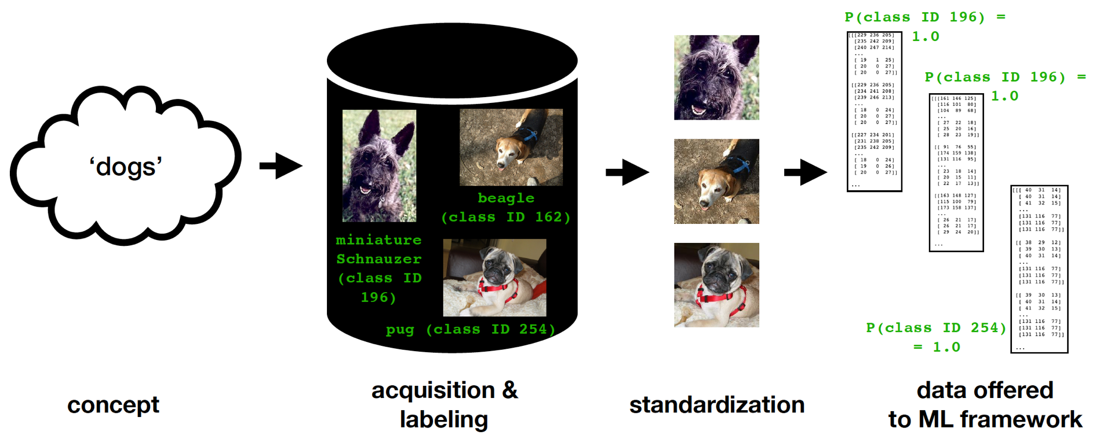
Standardization

Slide 16


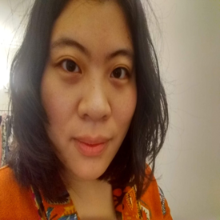


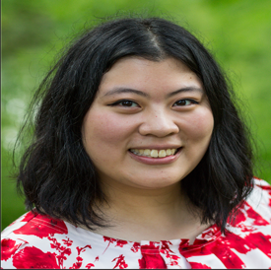
Standardization
original
cropped
scaled

Slide 17

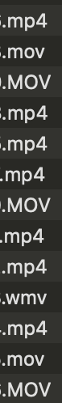
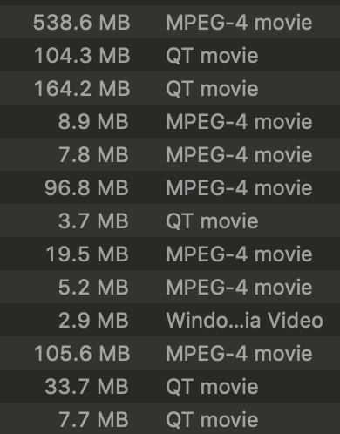
Standardization

Slide 18
The domain expert’s focus

Slide 19
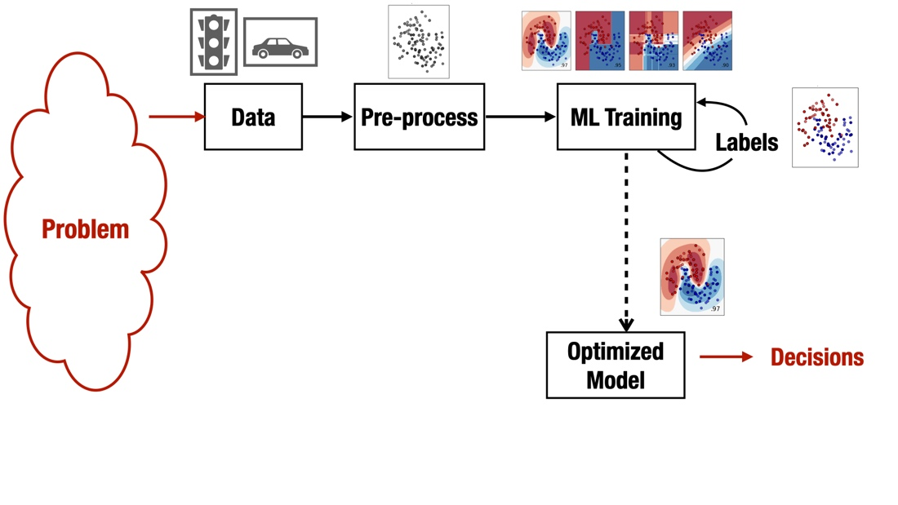
What it really may be about

Slide 20
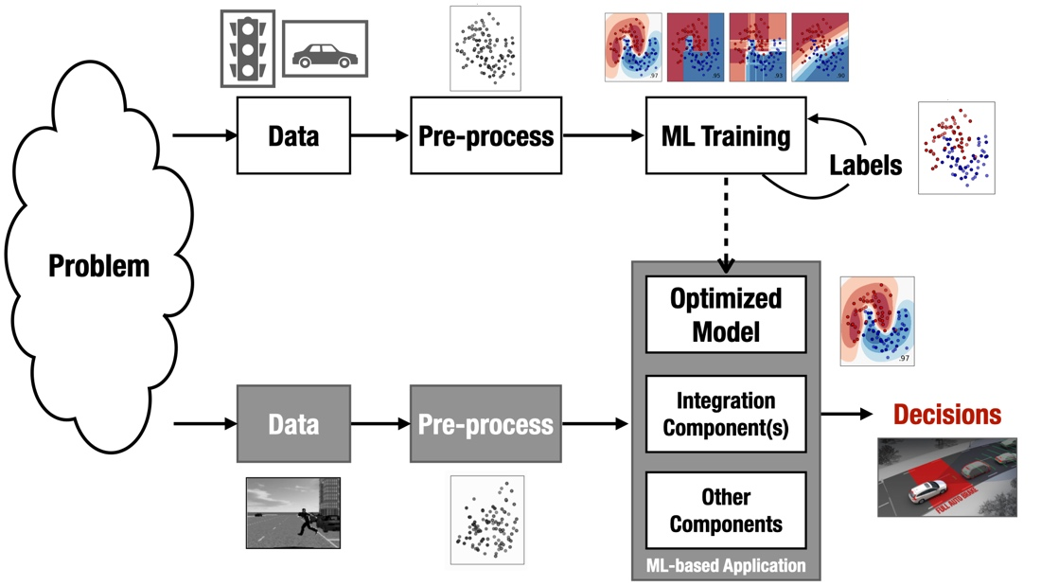
What it really may be about

Slide 21
What is ‘working as intended’? What is ‘the code’?
joint work on testing for ML with Annibale Panichella

Slide 22
Communicating for accountability

Slide 23
What if outcomes are bad?
https://www.smbc-comics.com/comic/ai-4
presented with permission by creator Zach Weinersmith

Slide 24
“I want to know exactly what the algorithm is doing”

Slide 25
UWV (Employee Insurance Agency)
For the Dutch-reading audience: https://www.uwv.nl/overuwv/Images/besluit-wob-verzoek-inzake-software-en-algoritmes.pdf
Source code of used software and algorithms
‘We use Python 3.7.5’
‘We also use SQL server 2016. It is licensed by Microsoft, we cannot share source code’
‘Python is open source so we won’t share code either’
‘Model can be found at https://github.com/scikit-learn/scikit-learn/blob/main/sklearn/ensemble/hist_gradient_boosting/gradient_boosting.py ’

Slide 26
UWV (Employee Insurance Agency)
For the Dutch-reading audience: https://www.uwv.nl/overuwv/Images/besluit-wob-verzoek-inzake-software-en-algoritmes.pdf
Source code of used software and algorithms
‘We use Python 3.7.5’
‘We also use SQL server 2016. It is licensed by Microsoft, we cannot share source code’
‘Python is open source so we won’t share code either’
‘Model can be found at https://github.com/scikit-learn/scikit-learn/blob/main/sklearn/ensemble/hist_gradient_boosting/gradient_boosting.py ’

Slide 27
UWV (Employee Insurance Agency)
For the Dutch-reading audience: https://www.uwv.nl/overuwv/Images/besluit-wob-verzoek-inzake-software-en-algoritmes.pdf
Source code of used software and algorithms
‘We use Python 3.7.5’
‘We also use SQL server 2016. It is licensed by Microsoft, we cannot share source code’
‘Python is open source so we won’t share code either’
‘Model can be found at https://github.com/scikit-learn/scikit-learn/blob/main/sklearn/ensemble/hist_gradient_boosting/gradient_boosting.py ’

Slide 28
UWV (Employee Insurance Agency)
For the Dutch-reading audience: https://www.uwv.nl/overuwv/Images/besluit-wob-verzoek-inzake-software-en-algoritmes.pdf
Source code of used software and algorithms
‘We use Python 3.7.5’
‘We also use SQL server 2016. It is licensed by Microsoft, we cannot share source code’
‘Python is open source so we won’t share code either’
‘Model can be found at https://github.com/scikit-learn/scikit-learn/blob/main/sklearn/ensemble/hist_gradient_boosting/gradient_boosting.py ’

Slide 29
UWV (Employee Insurance Agency)
For the Dutch-reading audience: https://www.uwv.nl/overuwv/Images/besluit-wob-verzoek-inzake-software-en-algoritmes.pdf
Source code of used software and algorithms
‘We use Python 3.7.5’
‘We also use SQL server 2016. It is licensed by Microsoft, we cannot share source code’
‘Python is open source so we won’t share code either’
‘Model can be found at https://github.com/scikit-learn/scikit-learn/blob/main/sklearn/ensemble/hist_gradient_boosting/gradient_boosting.py ’

Slide 30
UWV (Employee Insurance Agency)
For the Dutch-reading audience: https://www.uwv.nl/overuwv/Images/besluit-wob-verzoek-inzake-software-en-algoritmes.pdf
Source code of used software and algorithms
‘We have algorithm documentation, scripts and a Data Protection Impact Assessment. These will not be shared because of their strategic importance to our servicing.’

Slide 31
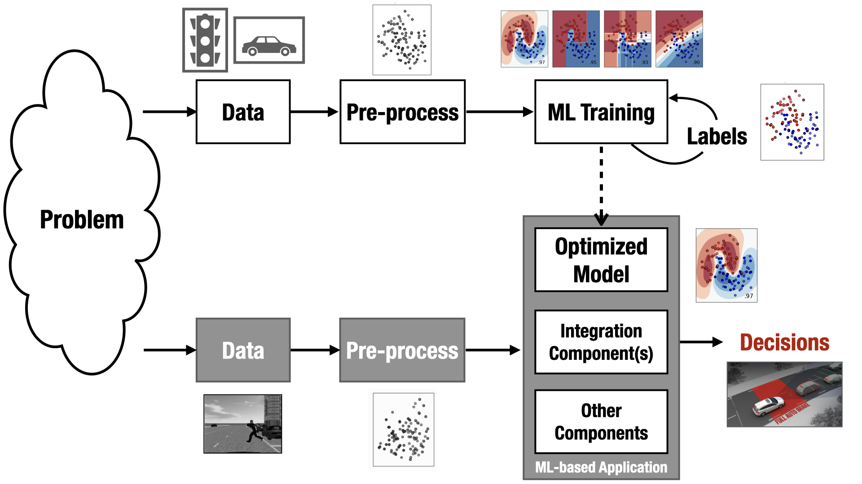
Common, problematic questions

Slide 32
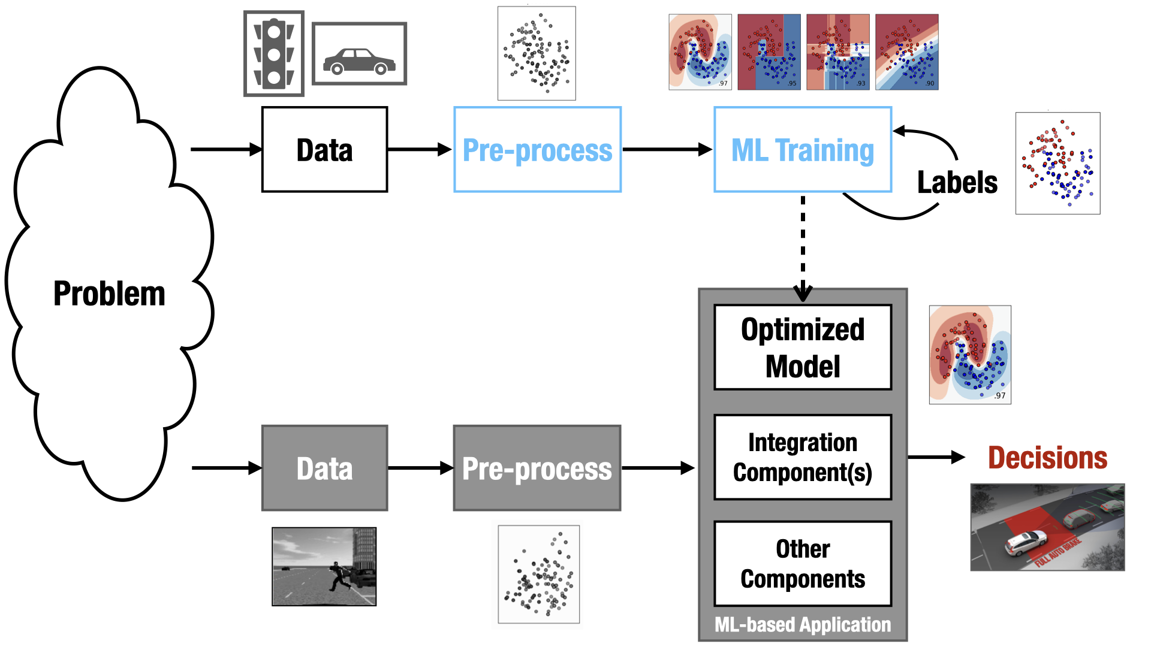
‘Can you walk me through the code?’

Slide 33
‘Should this sensitive attribute have been included?’

Slide 34
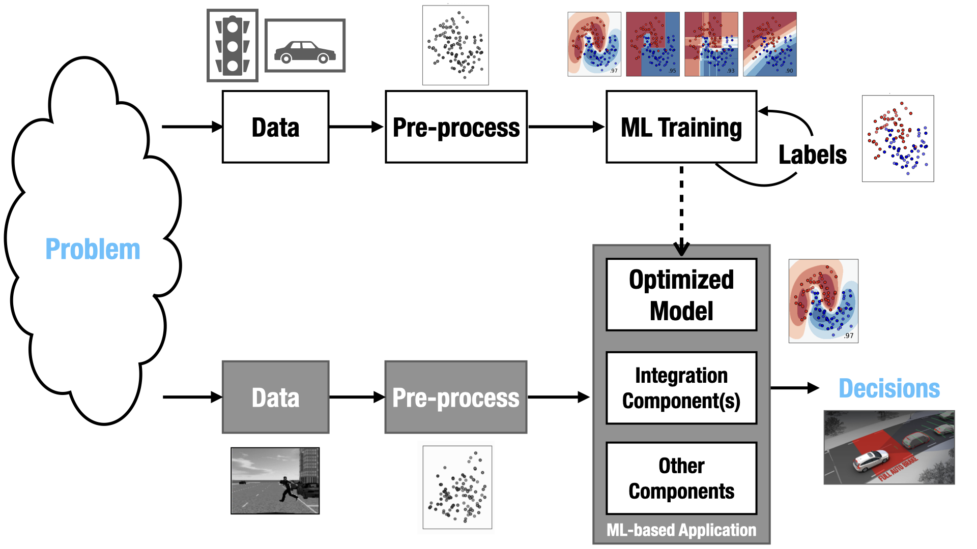
‘Should this sensitive attribute have been included?’

Slide 35
Communicating to laypeople
Notes:
Spend about 10 minutes on each concept

Slide 36
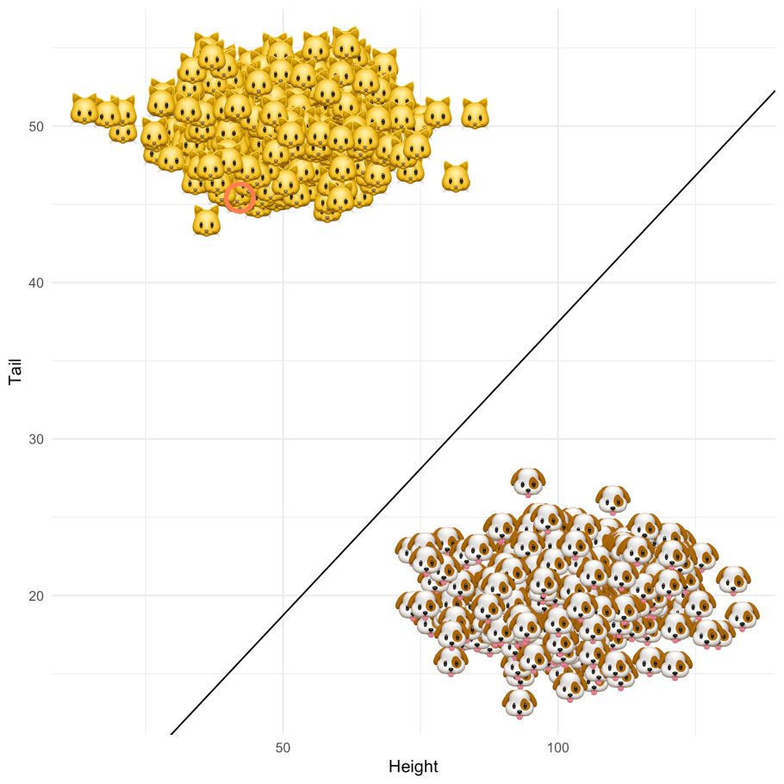
Learning patterns from data
illustration by Patrick Altmeyer

Slide 37
Learning patterns from data
illustration by Patrick Altmeyer
dog or cat?

Slide 38
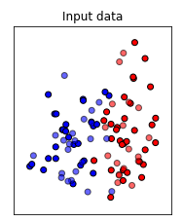
Learning patterns from data

Slide 39
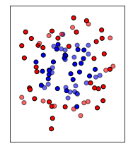
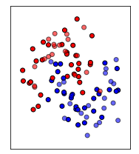
Learning patterns from data

Slide 40
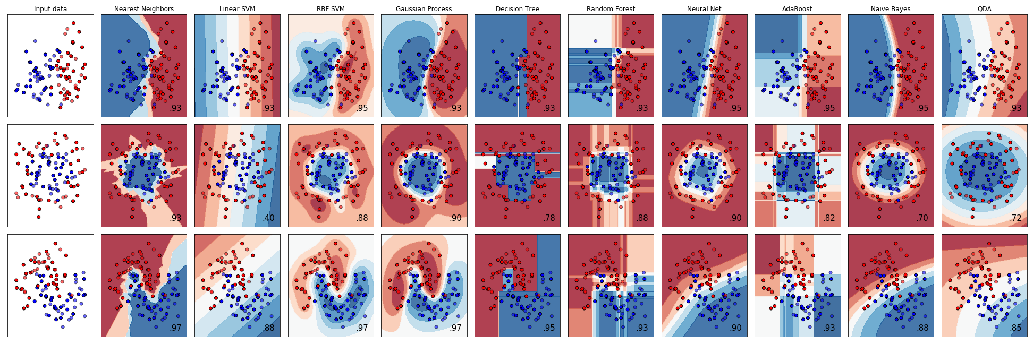
Learning patterns from data

Slide 41
Learning patterns from data

Slide 42
Learning patterns from data

Slide 43
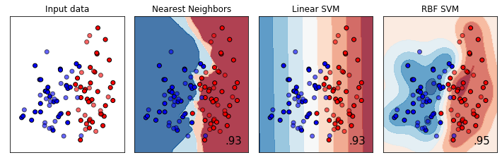
Learning patterns from data

Slide 44
From data to decision-making
*
*
*
*
x
*
*
x
*
*
*
x
*
x
x
x
x
x
x
x

Slide 45
From data to decision-making
.
.
*
*
*
.
*
x
.
*
*
.
x
.
*
*
*
.
.
.
x
*
.
x
.
.
.
x
x
x
.
x
.
x
x

Slide 46
What if you only can pick 5 points?
.
.
*
*
*
.
*
x
.
*
*
.
x
.
*
*
*
.
.
.
x
*
.
x
.
.
.
x
x
x
.
x
.
x
x

Slide 47
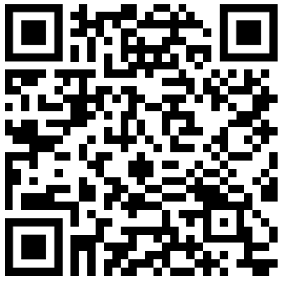
What if you only can pick 5 points?
https://tudelft.fra1.qualtrics.com/jfe/form/SV_3I8HIOZxBVamFIW

Slide 48
Exercise results
[note: this was not in the presentation, but compiles the interactive responses I received as of January 11, 2022 (n=7)]
Notes:
Spend about 10 minutes on each concept

Slide 49
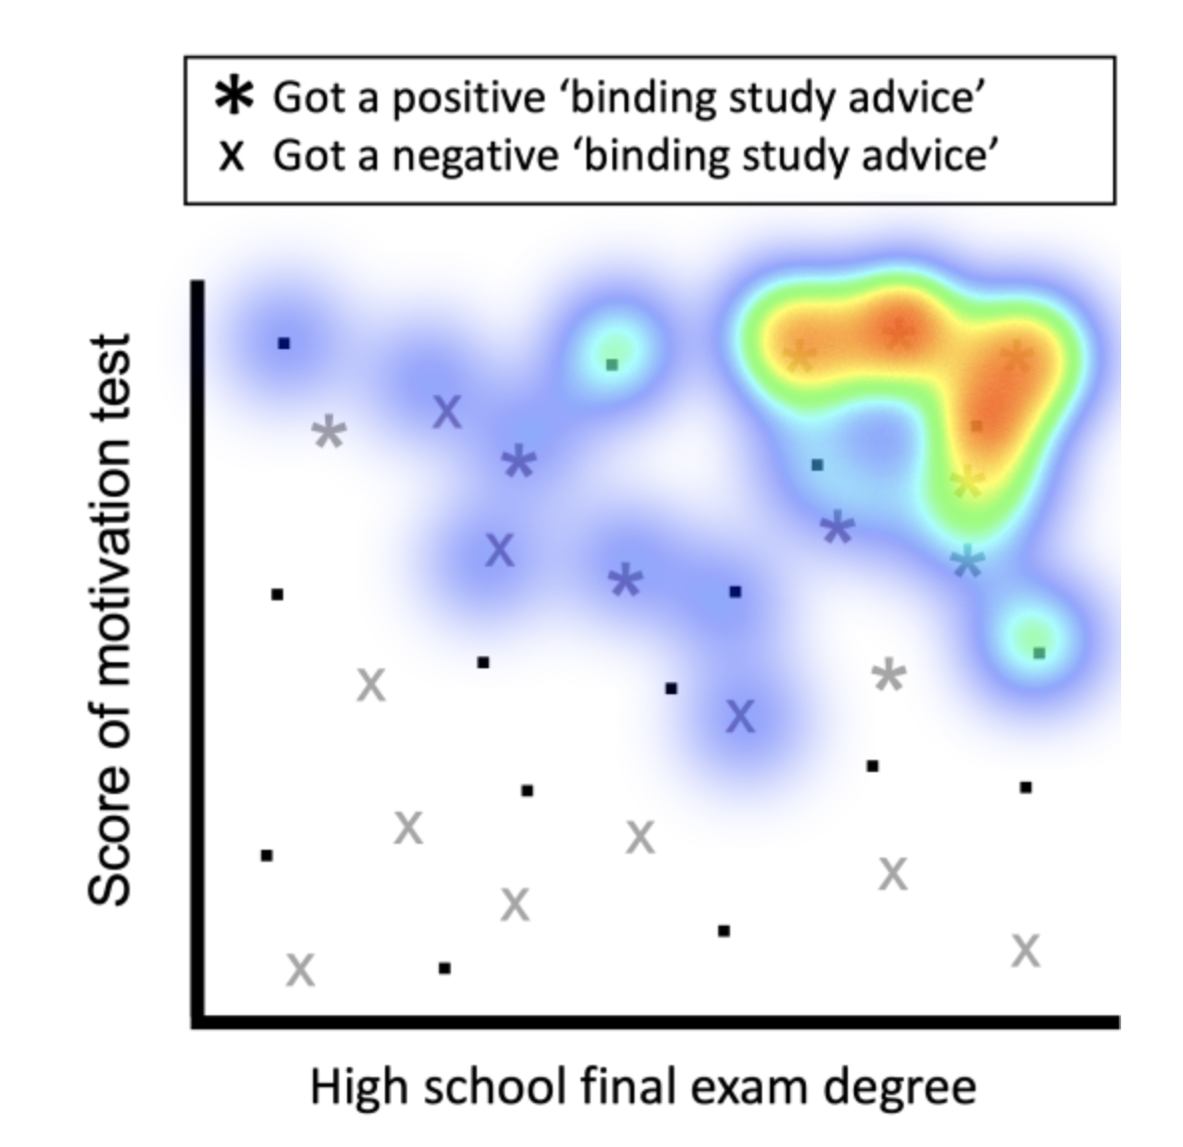
Student admissions

Slide 50
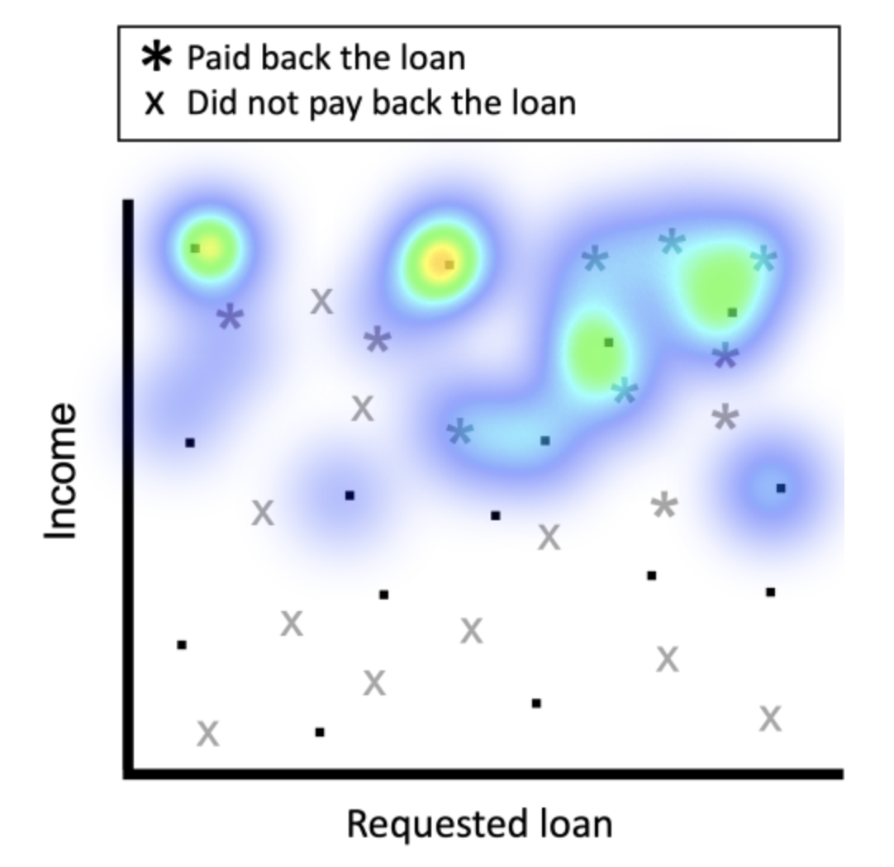
Loans

Slide 51
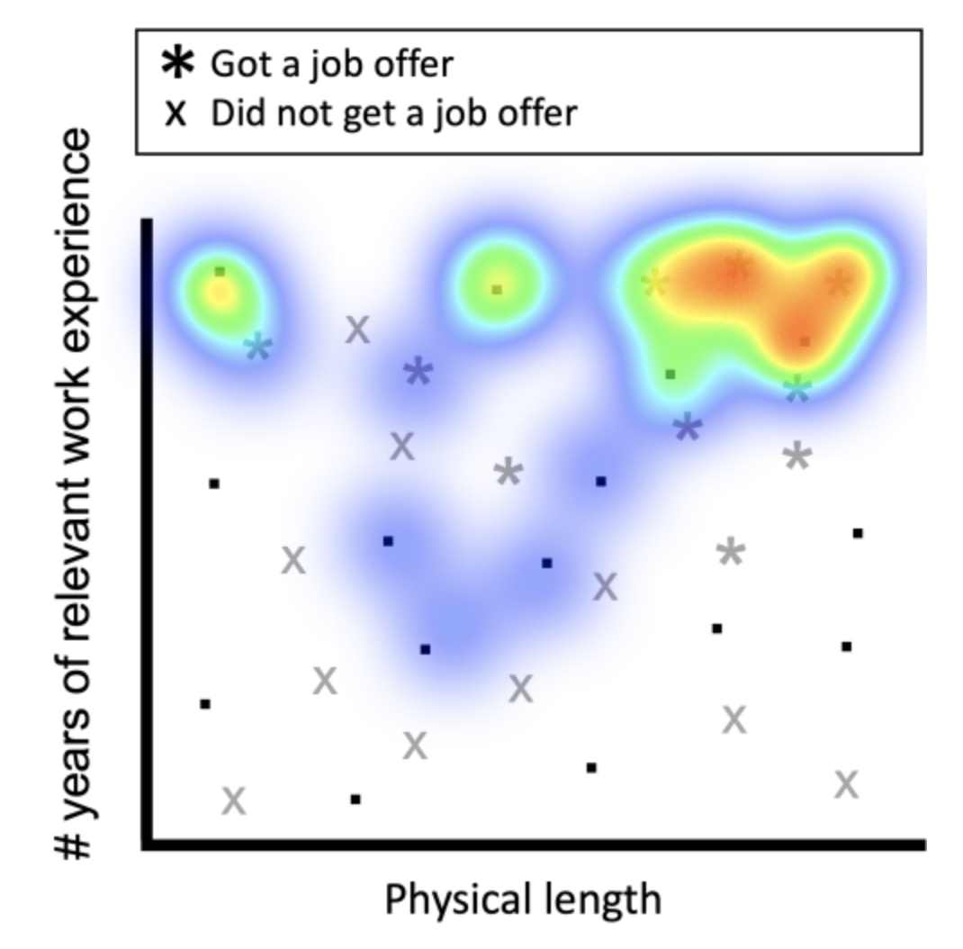
Job interviews

Slide 52
Observation
We looked at the exact same dataset, but with three different associated use cases and dimension interpretations. In terms of your responses, we can notice differences between these three use cases. Note that a predictive ML model would not naturally be able to distinguish between these three cases, if you would feed it exactly the same dataset.

Slide 53
Conclusion
We need to grow literacy.
Especially at the interfaces between data-driven pipelines and their surrounding contexts.
This goes beyond introductory ML and programming courses.
Notes:
Steer the focus of your audience using transparent blocks to . You create them by creating any shape. Make sure to set the border to transparent. Chose the fill color: Click on the same color as the background (in this case white) and click on the +sign under custom colors. This allows you to change the transparency. You can play around with the settings, but somewhere around 75% transparency should work.

Slide 54

Conclusion

Slide 55
References
C.C.S. Liem et al., Psychology meets Machine Learning: Interdisciplinary perspectives on algorithmic job candidate screening, in Explainable and Interpretable Models in Computer Vision and Machine Learning (pp. 197-253), 2018.
C.J. König et al., Some Advice for Psychologists Who Want to Work With Computer Scientists on Big Data, Personnel Assessment and Decisions, vol. 6 no. 1, 2020.
A. Panichella & C.C.S. Liem, What Are We Really Testing in Mutation Testing for Machine Learning? A Critical Reflection, 43rd Conference on International Conference on Software Engineering (ICSE) – New Ideas and Emerging Results, 2021.
Notes:
Add references as a slide so that you can share this with the audience. You don’t have to show this during the presentation.

Slide 56

if questions:
try:
answer()
except RuntimeError:
pass
else:
print("Thank You.")

